Slide 1
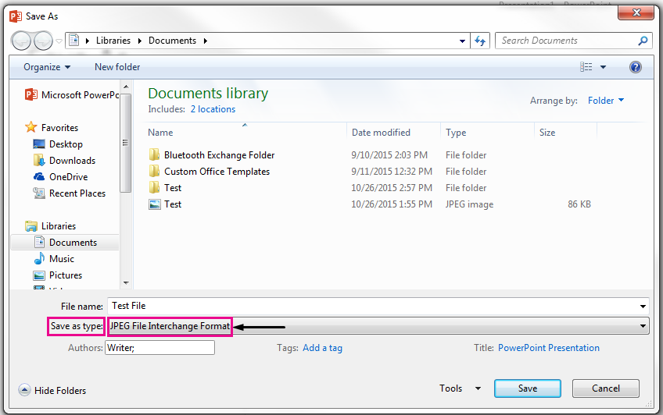
This is an important slide instruction don’t delete.
Save a single slide as an image to use with Announcement at portal.ad-din.ca
First update the slides as needed, in the slide thumbnail pane, on the left side of the PowerPoint window, select the slide you want to save.
Click File > Save As. Navigate to the folder where you want to save your slide.
Type the name of your slide image in the File name text box.
Click to open the Save as Type drop-down menu. Select one of the following image formats for your slide.
JPEG File Interchange Format (.jpg)
Select PNG Portable Network Graphics Format (.png)
Select GIF Graphics Interchange Format (.gif)
Click Save. Review the PowerPoint dialog box, and select Just This One to save your selected slide as an image.
Note: You can select All Slides to save each slide in your presentation as an image. Each slide will be saved as a separate file.

Slide 2
Islamic Foundation of Toronto
441 Nugget Ave, Scarborough, ON, M1S 5E1, Canada.
Office Timings
Monday to Thursday: | 01:00 PM - 08:00 PM
Friday: | 12:00 PM - 07:00 PM
Saturday and Sunday: | 01:00 PM - 06:00 PM
Contact Information
Phone: | 416-321-0909
 | 416-321-1995
Email: | info@islamicfoundation.ca
IFT Funeral Service 24/7 Phone Line: | 416-876-3000

Slide 3
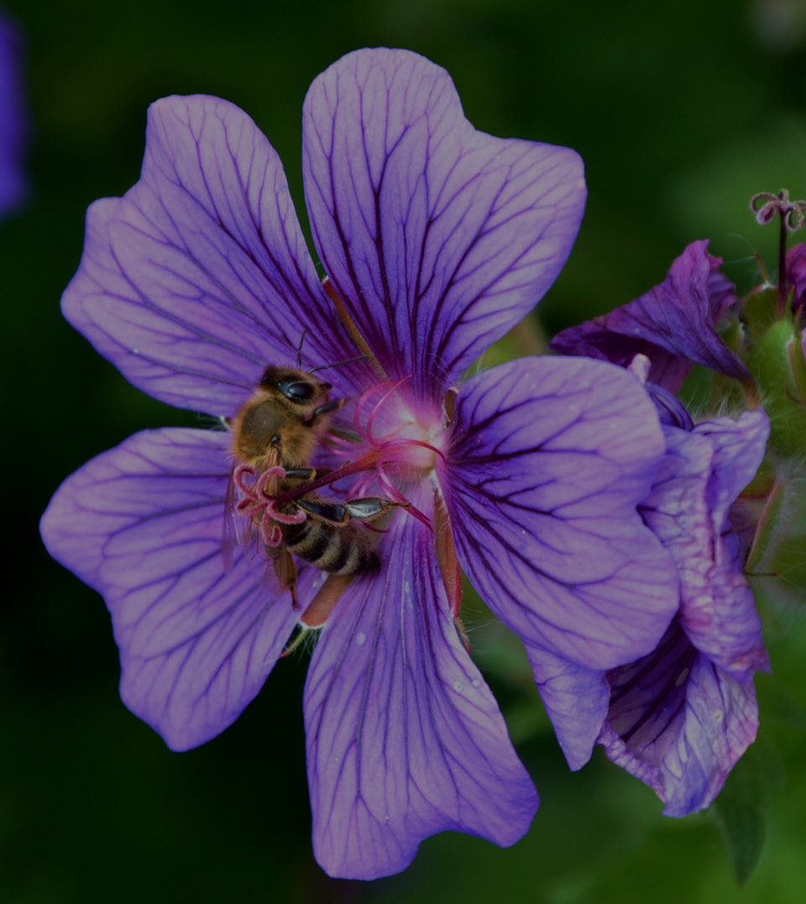

Slide 6
Need Urgent Donations to Replace Roof of the Masjid – Sadaqah Jariyah
Goal $100,000.00 Raised so far $35,000.00
Please Donate to Replace Roof of the Masjid - Sadaqa Jariyah
Donating for a good action and deed like this is a rewarding way for Sadaqa Jariyah
"When a man passes away, his good deeds will also come to an end except for three: Sadaqah Jariyah (ceaseless charity); a knowledge which is beneficial, or a virtuous descendant who prays for him (for the deceased)" Narrated by Abu Hurairah, Sahih Muslim
Normal wear and tear of Masjid’s roof over time has mounted and we continue to maintain the same with minor repairs. But, time has come to replace the roof of the Main Prayer Hall and the Gym urgently as the problem has been spreading in recent months and water can now be spotted seeping at several spots.
A sincere Thank You to the Community members who donated enough money to finance replacement of roof around the Dome previously. Now, we ask that you kindly consider how you can contribute to replace the roof for the Main Prayer Hall and Gym.

Slide 7
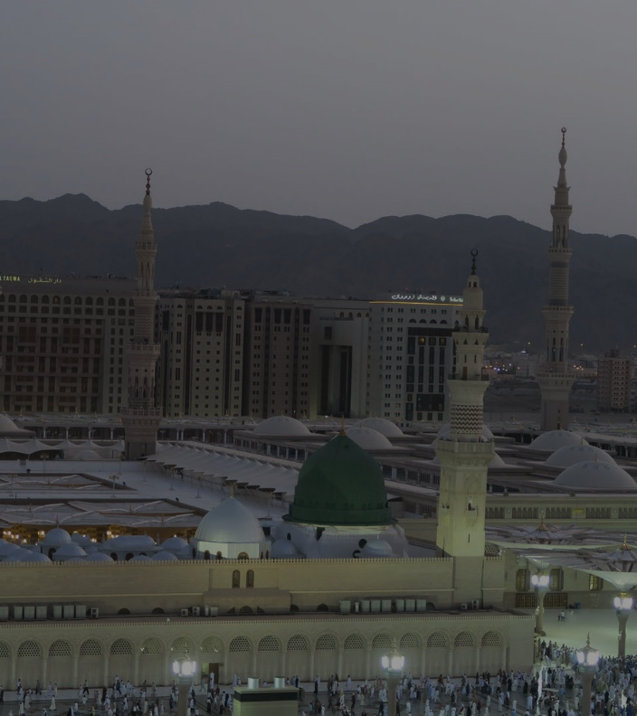

Slide 8
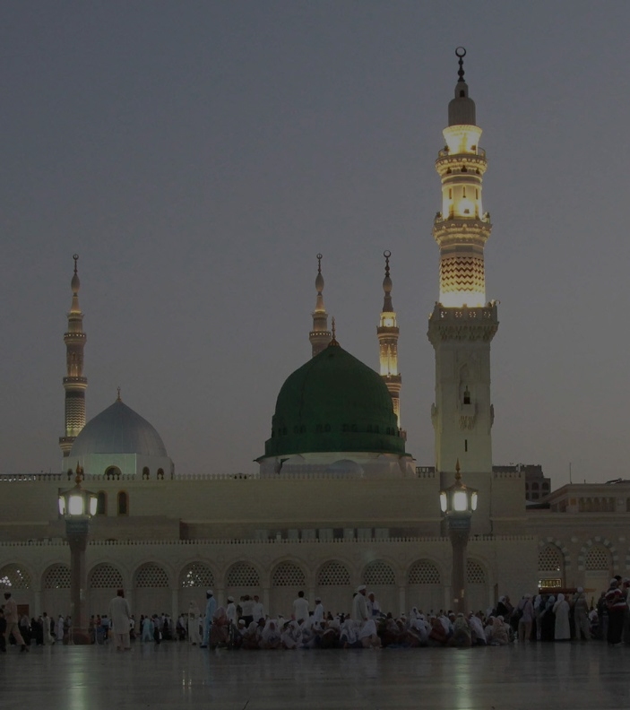

Slide 9
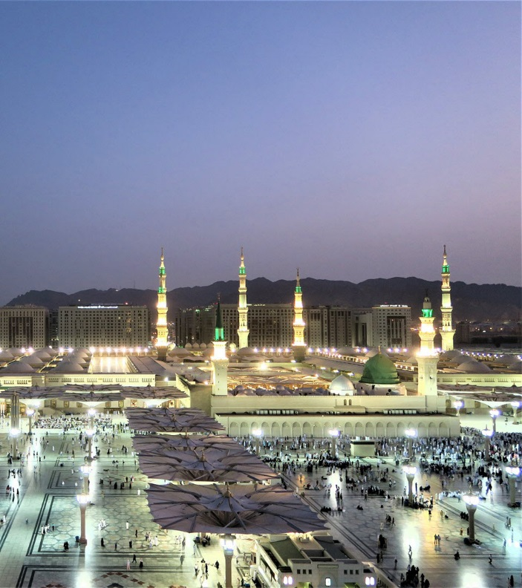
The Seerah of Prophet (pbuh) – Lecture Series
by Shaykh Yusuf Badat
Every Wednesday after Isha at Islamic Foundation of Toronto. Free Admission

Slide 10
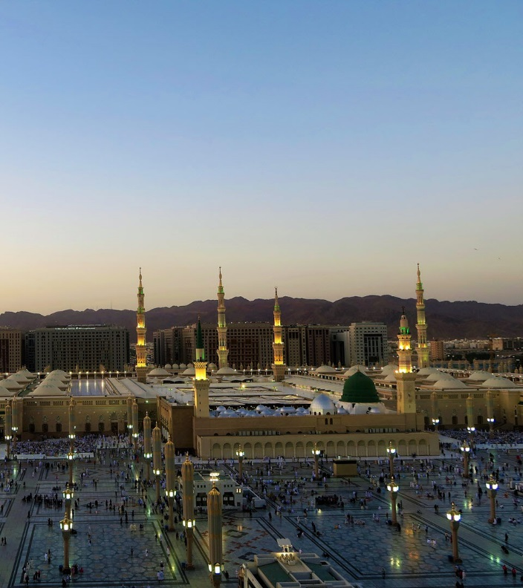

Slide 12
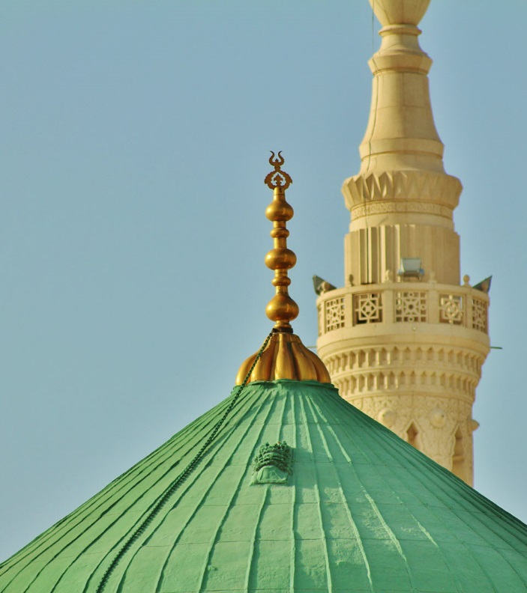

Slide 13
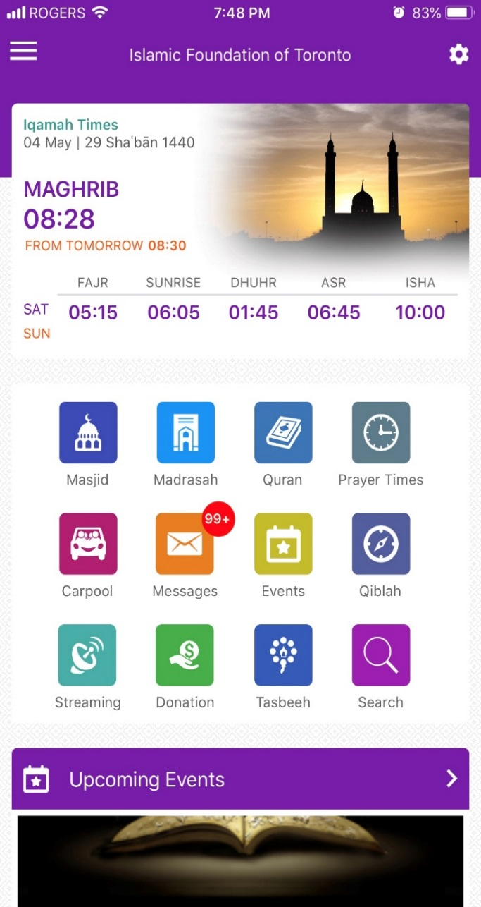
Download Jummuah Mosque’s
“Ad-Din” Mobile App
Three Easy Steps
Spiritual Society Canada
1
Download the “Ad-Din” Mobile App on your Smartphone
2
Signup With Your Username and Email
3
Set Jummuah Mosque as Home Masjid & Madrasah
Android
IOS

Slide 14
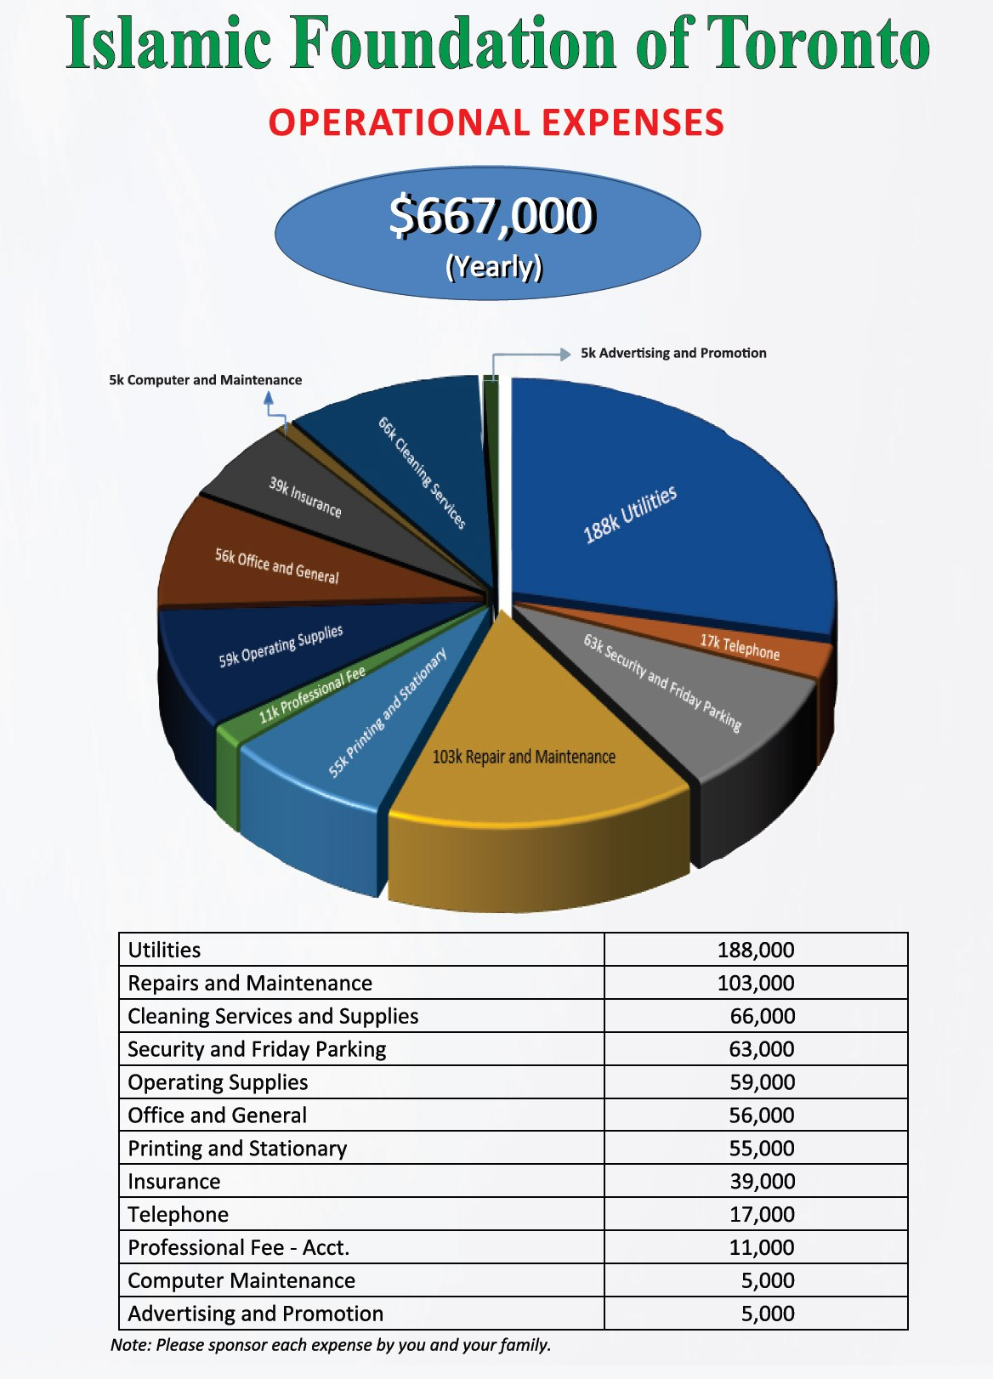

Slide 15
Dollar a Day Campaign
Raising $667,000 for Annual Expenses
We look forward to your support!
May Allah SWT reward you abundantly.

Slide 16
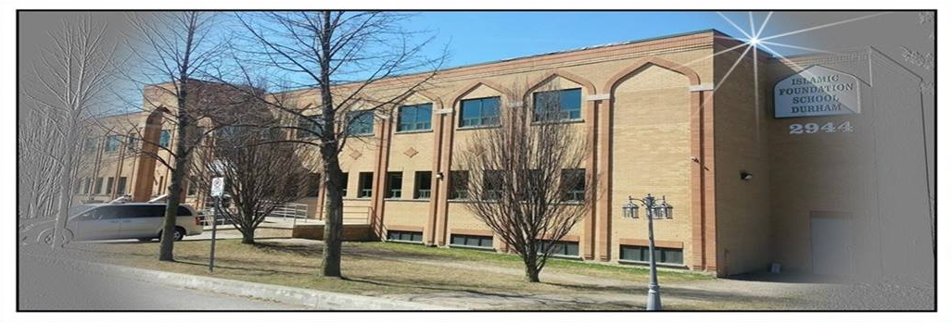
Islamic Foundation School Durham Ranked Top School in Ontario
We are proud to share the information to our Supporters, Community Members and Parents that IFS Durham has scored perfect 10 bench-marked against 3046 Ontario Schools. The areas where the testing was done is Reading, Writing and Math. This report card identifies successful schools and serves as an model to follow.

